Slide 1
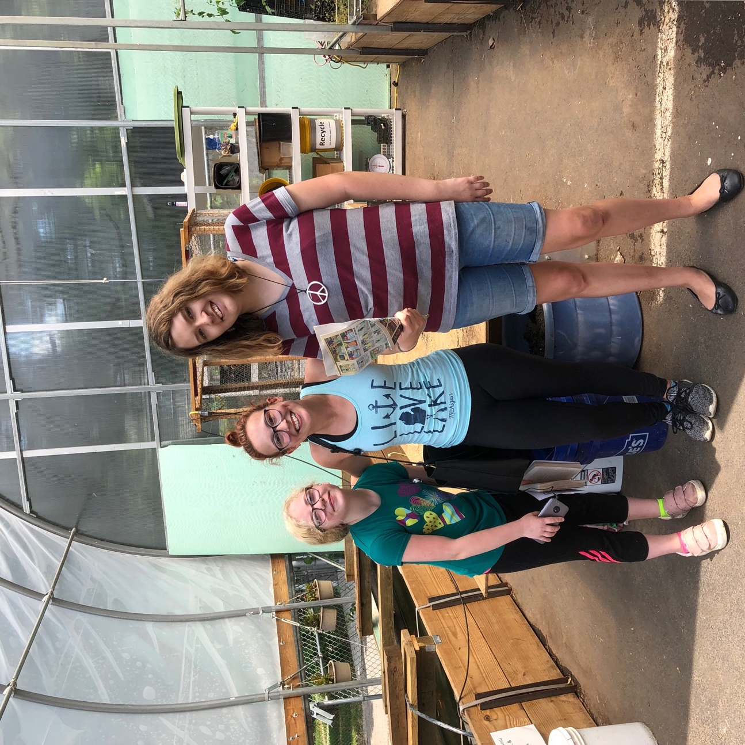
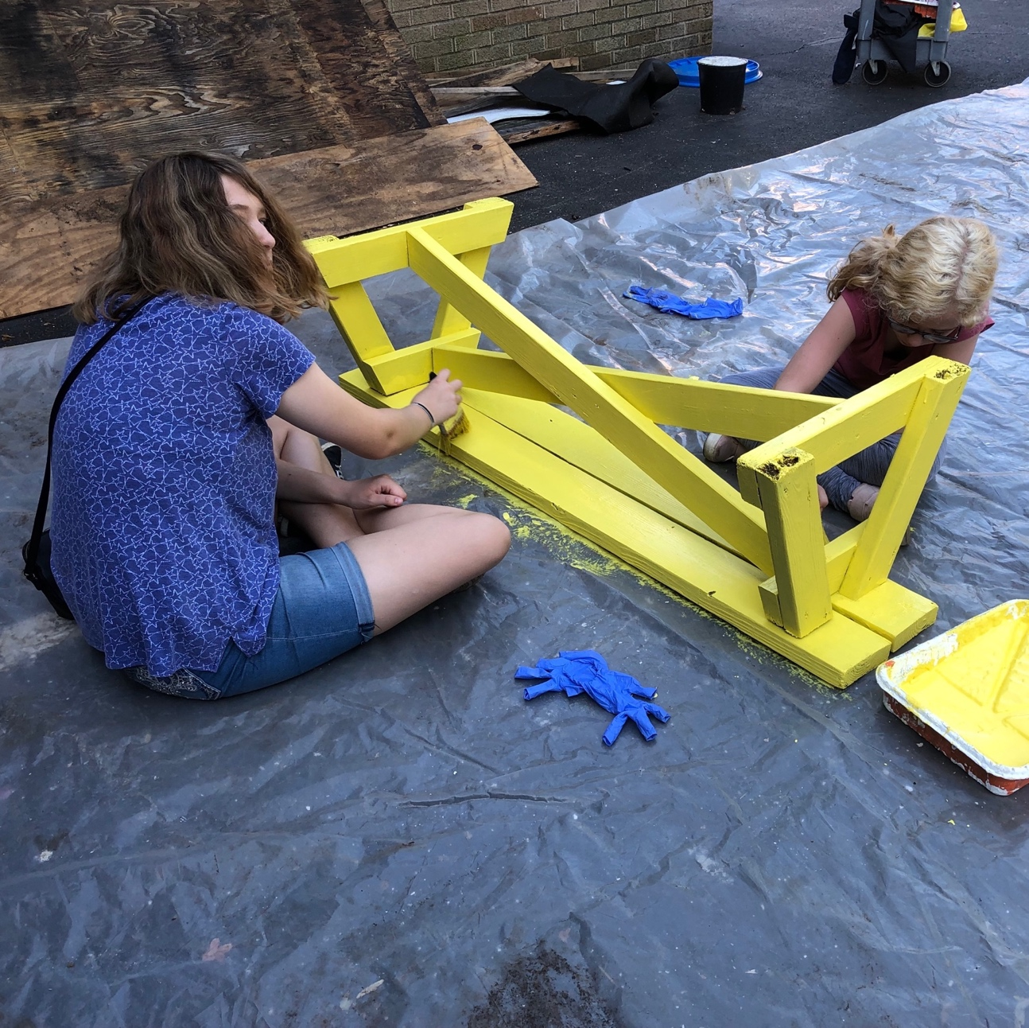



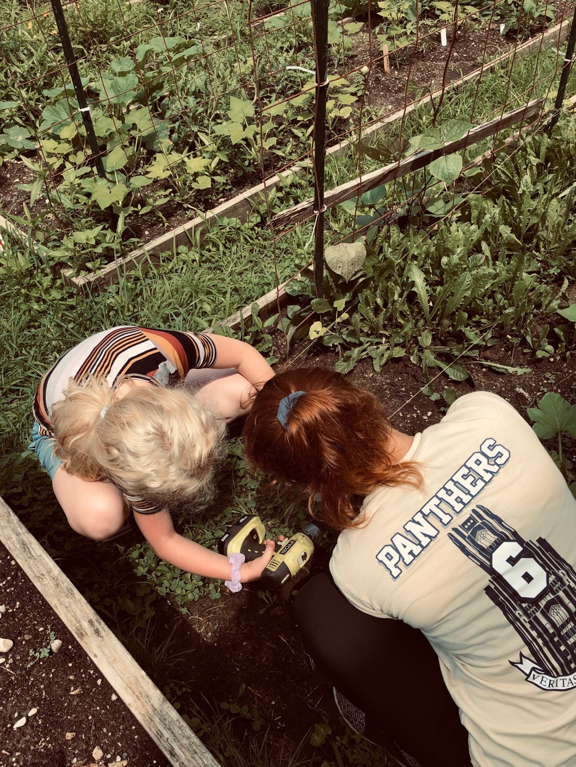
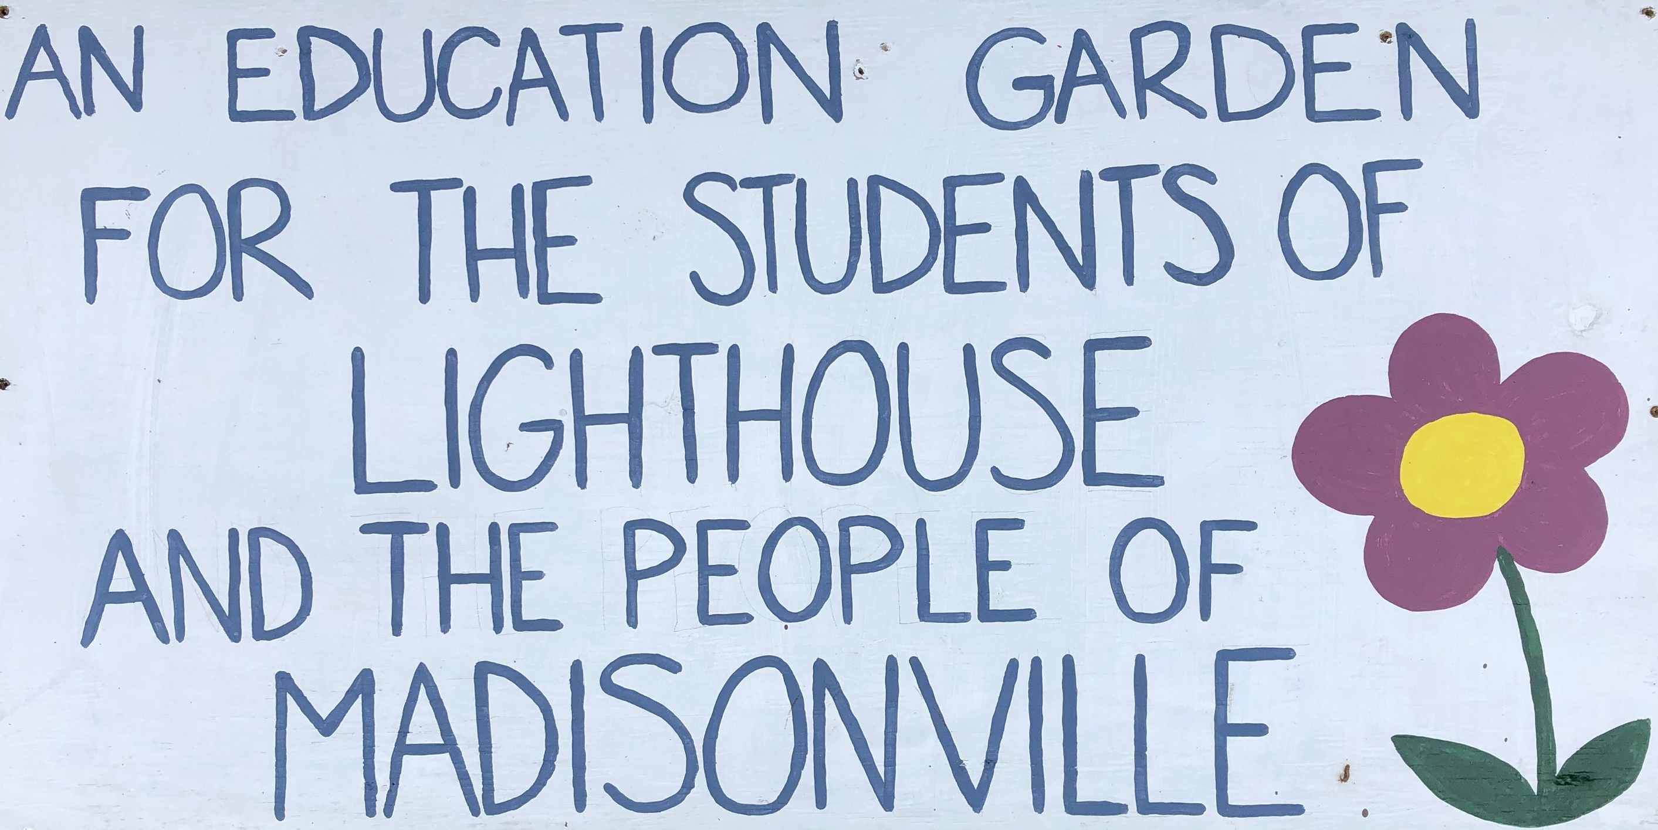
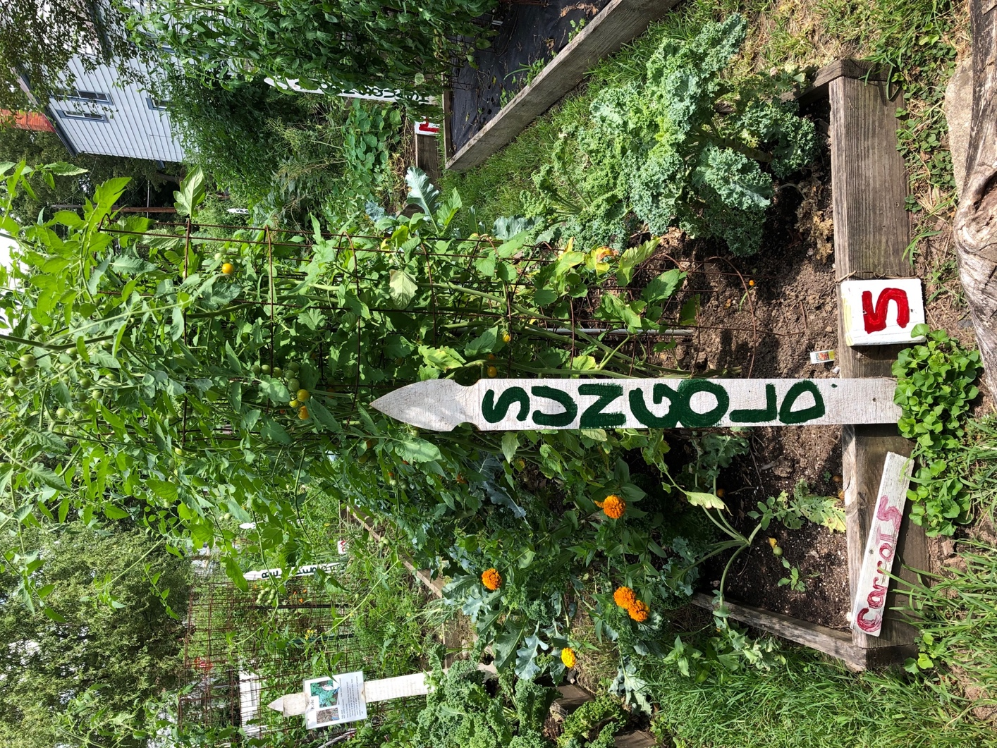
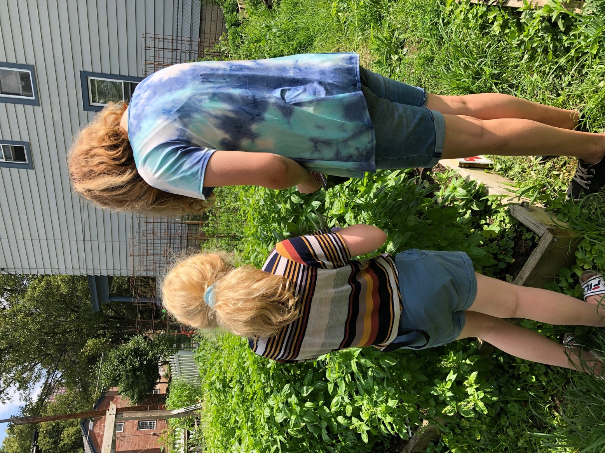
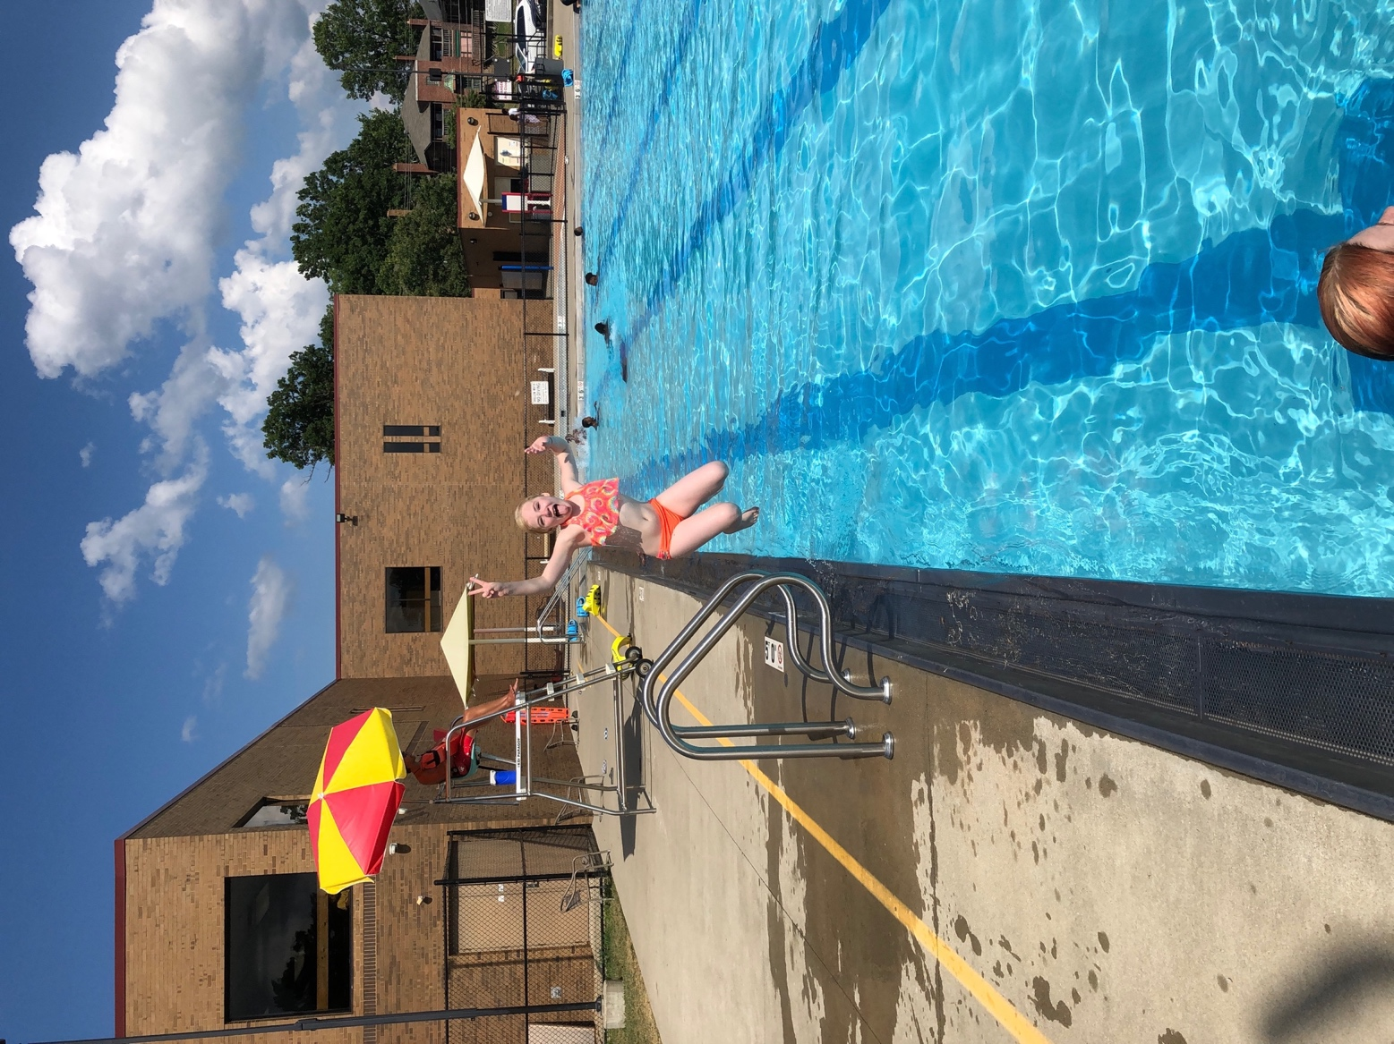

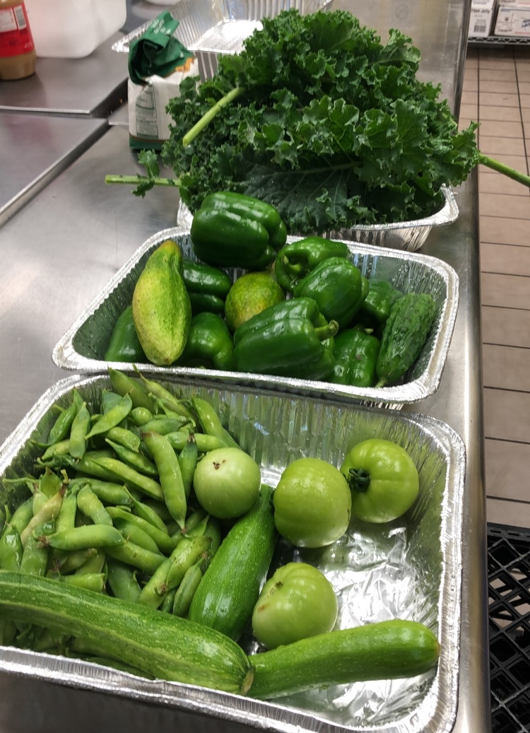
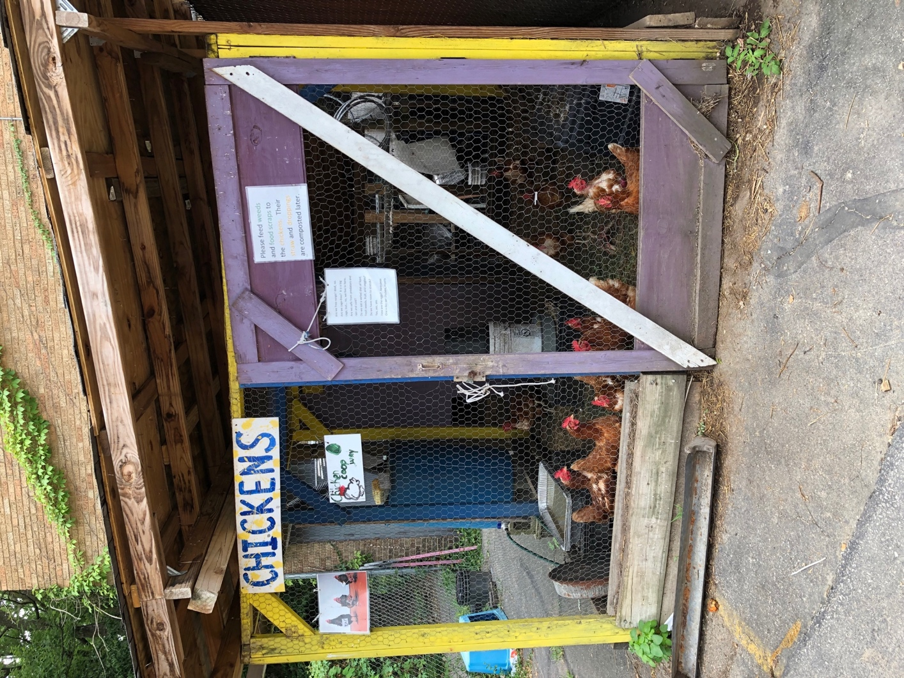

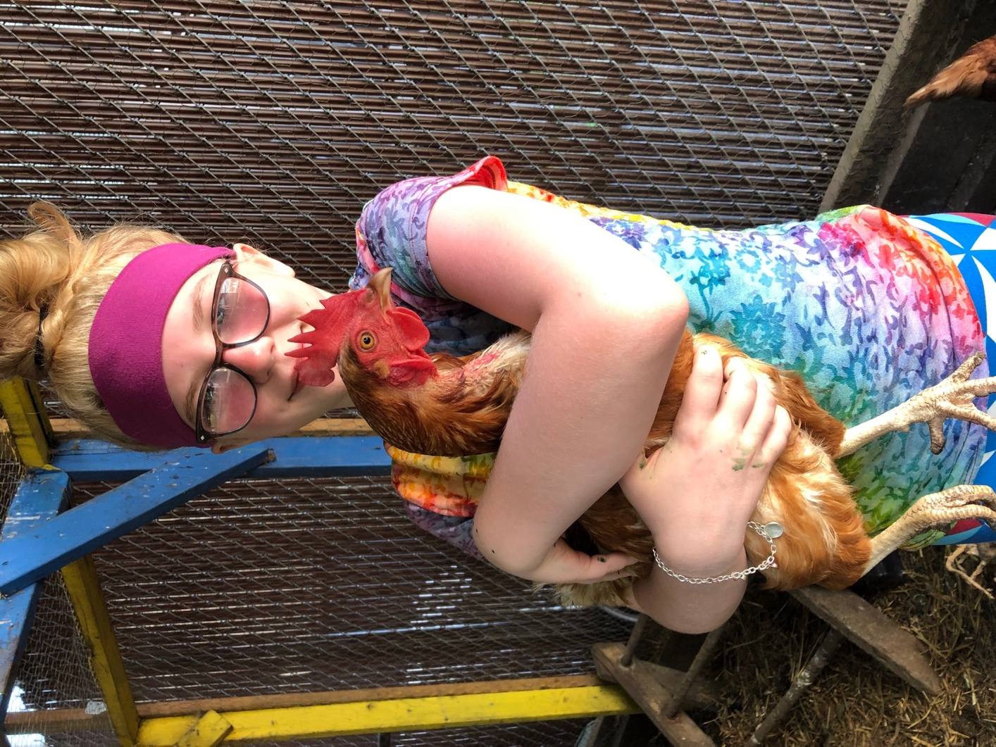
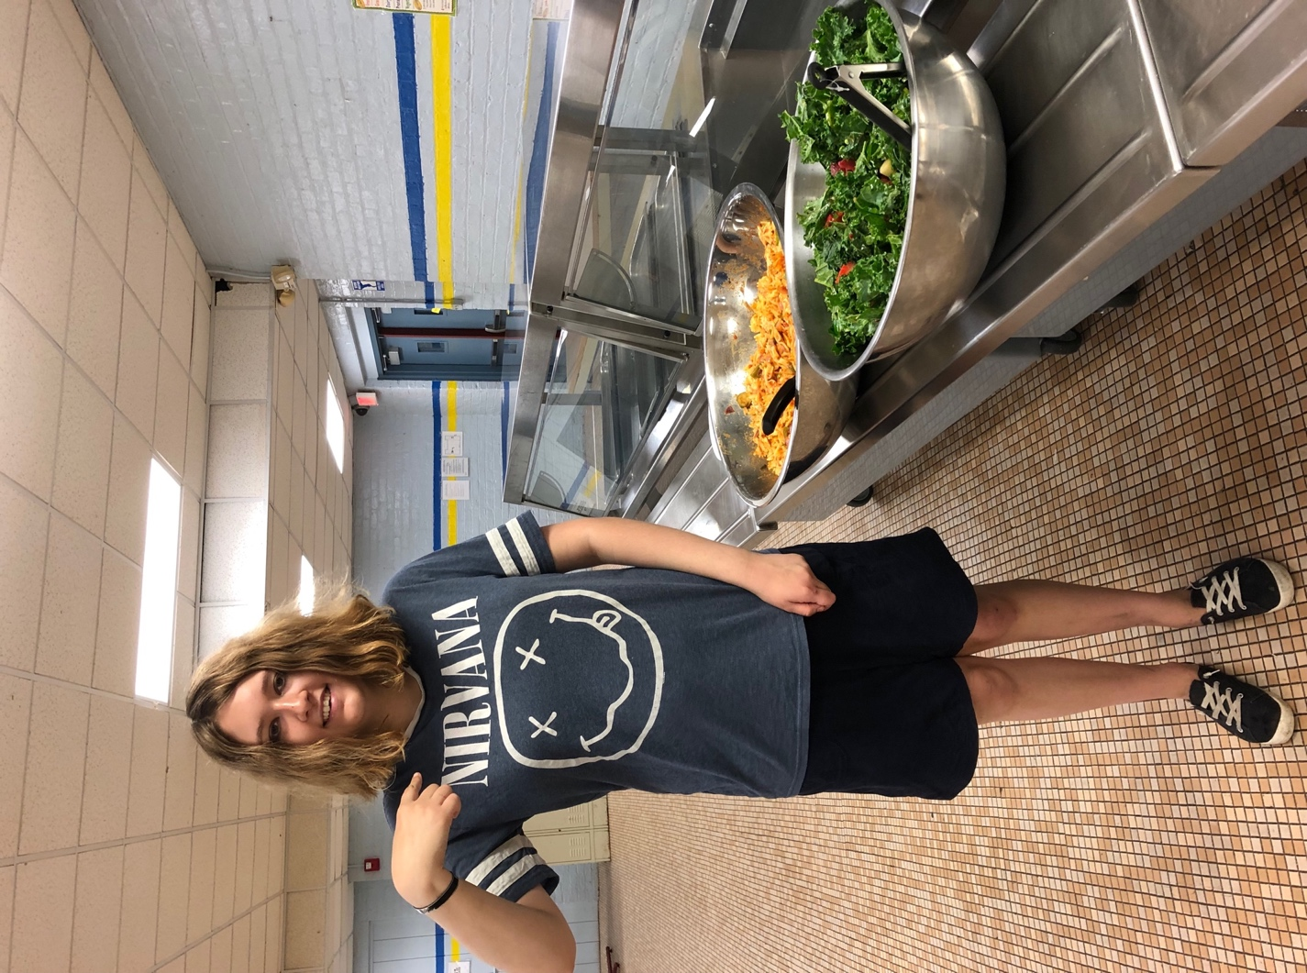

Lighthouse New Beginnings Urban Health Project – Summer 2019
Abigail Dillaha, University of Cincinnati College of Medicine
About the Site
Lighthouse New Beginnings is a therapeutic group home for girls age 11-17. The residents have all experienced significant forms of trauma and have been treated for psychiatric conditions. New Beginnings has a therapist in house who works with the girls to help them manage emotional difficulties and redirect problematic behaviors into healthy coping mechanisms. The staff members focus on teaching independent living skills so the girls are eventually prepared to find jobs and live on their own. Ultimately, New Beginnings serves to help the girls in their transition to foster/adoptive homes or independent living.
About the Work Program
In the summer, the girls at New Beginnings have the opportunity to work four days a week at Lighthouse Community School. The school has an urban agriculture program where the girls learned how to garden and take care of animals. This job was a great chance for the girls to learn responsibility and teamwork skills. We worked together on several large projects such as harvesting vegetables and cooking a meal, cleaning and organizing the greenhouse, and painting and installing signs on all of the garden beds. The girls gained valuable work experience while getting lots of fresh air!
Intern Duties
I spent much of my time with two residents at the summer work program at Lighthouse Community School. I also sat in on group and individual therapy sessions. In the afternoons when the girls didn’t have work or therapy, we would walk to the park or the pool, play games, watch movies, or do arts and crafts.

